Slide 1
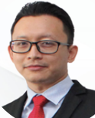
DR AHMAD SYUKRI JAMALUDIN
Former Regional Chief Executive Officer, Central 2 (KPJ Damansara Specialist Hospital, KPJ Damansara Specialist Hospital 2, KPJ Rawang Specialist Hospital, KPJ Selangor Specialist Hospital, KPJ Klang Specialist Hospital
Former Chief Executive Officer, KPJ Bandar Maharani Specialist Hospital
Currently the Chief Executive Officer of Azzahrah Group
Experience in overseeing and managing the construction and subsequent operation of KPJ Damansara Specialist Hospital 2
Notes:
Keunikan kumpulan az-zahrah ialah hospital yang mesra ibadah. Hospital az-zahrah ada pelbagai disiplin, dan mampu milik , harga 40% lebih murah dari hospital persendirian yg lain

Slide 2
DR AHMAD SYUKRI JAMALUDIN
Dr. Ahmad Syukri bin Jamaludin is an accomplished medical professional and healthcare executive with extensive experience in clinical practice, hospital operations, and strategic leadership across both public and private healthcare sectors.
He began his secondary education at Sekolah Alam Shah, Kuala Lumpur, and completed the International Baccalaureate programme at MARA College Banting, Selangor. He subsequently pursued a dual degree in Medical Science and Medicine (MB BCh BAO) at University College Cork, Republic of Ireland, and later earned a Master of Business Administration (MBA) from UNITAR International University.
Dr. Syukri commenced his medical career in the Republic of Ireland before returning to Malaysia, where he served at Pusat Perubatan Universiti Kebangsaan Malaysia (PPUKM). He went on to serve in government hospitals, including Port Dickson Hospital, and held a role at the Planning Department of the Ministry of Health Malaysia.

Slide 3
DR AHMAD SYUKRI JAMALUDIN (cont’d)
In the private sector, Dr. Syukri has held several key leadership positions. He served as Assistant General Manager of Hospital Islam Az-Zahrah and later as Chief Medical Officer of Megaklinik Zahran. He then joined KPJ Healthcare Berhad, where he progressed through various senior roles, including Clinical and Operations Manager of KPJ Seremban Specialist Hospital, and subsequently Chief Executive Officer of KPJ Maharani Specialist Hospital.
His last appointment within KPJ Healthcare Berhad was as Group Chief Executive Officer of KPJ Damansara Specialist Hospital (DSH) and KPJ Damansara Specialist Hospital 2 (DSH2). He also concurrently served as the Covering Regional CEO for Central Region 2, overseeing KPJ Klang Specialist Hospital, KPJ Rawang Specialist Hospital, and KPJ Selangor Specialist Hospital.

Slide 4
DR AHMAD SYUKRI JAMALUDIN (cont’d)
Currently, Dr. Syukri serves as the Chief Executive Officer of Hospital Islam Az-Zahrah, where he is leading operational improvements and overseeing the hospital’s strategic expansion initiatives.
With a strong foundation in both clinical and non-clinical leadership, Dr. Syukri has played a pivotal role in elevating healthcare standards. Under his leadership, KPJ Damansara Specialist Hospital and KPJ Damansara Specialist Hospital 2 were recognised by Global Health Asia Pacific in 2023 as the Best Women’s Health Hospital in Asia Pacific and Best New Hospital in Asia Pacific, respectively.

Slide 5
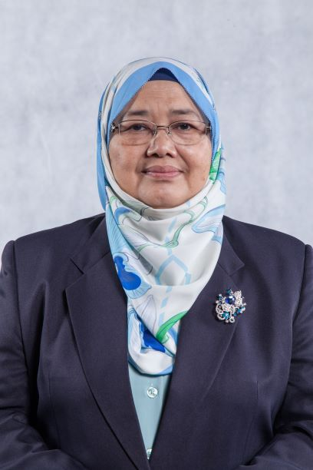
ZALILA BINTI MOHD TOON
Former Chief Executive Officer, Amanah Raya-Kenedix REIT Management Sdn Bhd, Manager of Amanah Raya-Kenedix REIT
Former Chief Financial Officer/Executive Director, Hektar Asset Management Sdn Bhd, Manager of Hektar REIT
Currently consulting for Azzahrah Group on strategic matters which includes the expansion of its hospital business
Notes:
Keunikan kumpulan az-zahrah ialah hospital yang mesra ibadah. Hospital az-zahrah ada pelbagai disiplin, dan mampu milik , harga 40% lebih murah dari hospital persendirian yg lain

Slide 6
ZALILA BINTI MOHD TOON
Zalila was the Executive Director cum Chief Financial Officer of Hektar Asset Management Sdn Bhd (“HektarAM”), manager of Hektar REIT for 12 years until her resignation in January 2018. She was instrumental for the structuring and listing of Hektar REIT on Bursa Malaysia’s Main Board in 2006; and grew the assets under management from RM500 million to RM1.2 billion via assets acquisition.
She was responsible for the financial matters, strategy, investor relations, legal and corporate affairs of Hektar REIT and Hektar AM. She was appointed as Chairman of the Due Diligence Working Group for the various corporate exercises undertaken by Hektar REIT such as the IPO and Rights Issue Exercise. She was the Designated Licensed Director under the Capital Market Services Representative’s License granted to REIT Managers. She also oversaw the Property Manager that manages all 6 shopping malls under Hektar REIT and was involved with strata title matters and issues with the Joint Management Body of one of the Malls.

Slide 7
ZALILA BINTI MOHD TOON (cont’d)
Thereafter, she became the Chief Executive Officer of AmanahRaya-Kenedix REIT Manager Sdn Bhd, (“AKRM”) manager for AmanahRaya REIT, which has a diversified portfolio of 15 properties, ie office buildings, education, retail, logistics and hospitality. Total Assets under management was over RM1 billion. She oversaw both the management of the REIT, AKRM and the Property Managers at the respective properties.
From 2022 to present, she is the Corporate Strategy Adviser for Kumpulan Syarikat Az-Zahrah. She was involved in the corporatization and expansion program of the group and in the acquisition of a piece of land for hospital expansion. Together with the Group’s Team, several presentations were made to prospective investors.

Slide 8
ZALILA BINTI MOHD TOON (cont’d)
Prior to joining Hektar in 2004, she was with the UEM Group for 23 years, out of which 20 years was with Cement Industries of Malaysia Berhad, where she steadily rose from an Accountant to General Manager Finance and Corporate Affairs. Her primary achievements included spearheading various corporate exercises and acquisition of a cement plant, including a due diligence exercise of a cement plant in India. Subsequently, she was also involved in the reverse take-over exercise of Park May Berhad before leaving for a brief stint in UEM Environment Sdn Bhd, a holding company of Kualiti Alam Sdn Bhd.
Zalila holds a Master of Business Administration (Finance) from the University of Nottingham.

